Slide 1
Copilot Scavenger Hunt Challenge

Slide 2
Scavenger Hunt
The challenge
How it works
Users receive a slide with 10 tasks to complete using Copilot and Copilot Chat. Each task includes a few steps to complete. Once completed, the user will take a screenshot of their result and paste it into the scavenger hunt slide as proof of completion.
10 challenges to complete
1
2
3
4
5
Encourage hands-on engagement through this scavenger hunt challenge that helps your employees experience using Copilot and Copilot Chat through a fun activity.
A Copilot license is required for some of the tasks.
Catch up on email threads in Outlook
Get action items from a Teams meeting
Research a company's market share
Gather information with Chat
Draft an email response in Outlook
6
7
8
9
10
Craft a well thought out prompt
Brainstorm ideas with Chat
Create a presentation from a file
Create a formula in Excel
Create your mascot in Chat
How to execute
Share a copy of the scavenger hunt slides 4-15 with each user
Answer questions as needed
(optional) Note down user start times and finish times for prizes for fastest completion
(optional) Adjust the tasks based on your specific use cases.

Slide 3
How it works
You will complete 10 challenges using Microsoft 365 Copilot and Copilot Chat.
Descriptions and instructions for the tasks can be found on slides 4-13.
Once completed, take a screenshot of your completed challenge and paste it into the designated box on your trophy wall.
Let your instructor know when you completed all your challenges.

Slide 4
Your Copilot Scavenger Hunt Trophy Wall
Complete all 10 challenges and paste a screenshot of your task in each respective box below. Just click on the image placeholder and paste the image
1. Catch up on emails
2. Get action items
3. Summarize your week
4. Gather information
5. Draft an email response
6. Create an executive summary
7. Brainstorm ideas
8. Create a presentation
9. Analyze data
10. Minecraft yourself
Let your instructor know once you have successfully completed all challenges

Slide 5

Challenge #1: Catch up on emails
Use Copilot in Outlook to quickly catch up on long email threads
1
Open Outlook
2
Select an email thread
3
Click on “Summary by Copilot” → Copilot will summarize the email thread
4
Click on “Ask Copilot” → The Copilot bar will open on the right
5
Ask Copilot a follow-up question
For example: “Are there any immediate action items for me?” or “Is there a deadline I should be aware of?”
6
Take a screenshot of Copilot’s response and paste it in box 1 on your trophy wall

Slide 6

Challenge #2: Get action items from a meeting
Use Copilot in Teams to list action items for your team
1
Open a recording of a Teams meeting
2
Click on the Copilot icon on the top right
3
Use this prompt:
“List all action items, the person responsible and any due dates that were discussed in this meeting.”
4
Take a screenshot of Copilot’s response and paste it in box 2 on your trophy wall

Slide 7

Challenge #3: Research a company's market share
Use Researcher to provide you with a report of an organization of your choice
1
Open Copilot Chat
Make sure you use the “work” tab on the top
2
Use this prompt:
“Analyze the market position of [Company].”
3
Respond to the questions that Researcher asks you.
4
Take a screenshot of Copilot’s response and paste it in box 3 on your trophy wall

Slide 8

Challenge #4: Gather information
Use Copilot Chat to gather information about a project
1
Open Copilot Chat
Make sure you use the “work” tab on the top
2
Think of a project you are working on and use this prompt:
“Look through my emails, messages, meetings and documents in the last [insert time frame, like 3 weeks] and create a comprehensive overview of the latest information for [insert project name].”
3
Take a screenshot of Copilot’s response and paste it in box 4 on your trophy wall

Slide 9

Challenge #5: Draft an email response
Use Copilot in Outlook to draft a polished email response
1
Open Outlook
2
Select an email thread and hit ‘reply’ or ‘reply all’
3
Click the Copilot icon in the body of the email  A Copilot prompt box will open up
4
Now use this prompt:
“Draft a response saying [insert a brief description of what you want to say].”
5
Copilot will now draft a response for you
6
In the Copilot box, select “Change Tone” and then select “professional” → Copilot will adjust the draft to sound more professional
7
Take a screenshot of Copilot’s response and paste it in box 5 on your trophy wall

Slide 10

Challenge #6: Craft a well thought out prompt
Use the Prompt Coach agent to create a prompt that meets your goals
1
Open Copilot Chat
Make sure you use the “work” tab on the top
2
Go to the side pane on the right, and select Prompt Coach
3
Use this prompt:
“Catch me up on everything I missed in the last two weeks, especially messages from my manager.”
4
Next answer the questions about prompt coach, to make this prompt even better.
5
Take a screenshot of Copilot’s response and paste it in box 6 on your trophy wall

Slide 11

Challenge #7: Brainstorm ideas
Use Copilot Chat to brainstorm ideas
1
Open Copilot Chat
2
Choose one of these prompts to brainstorm ideas with Copilot. You can also create your own prompt:
“Give me 5 creative ideas for remote team building exercises for my team of [insert number] people.”
“Based on this presentation /[select PowerPoint deck], give me 10 ideas for a creative name for this campaign.”
“Look through this survey data /[select Excel sheet] and brainstorm 5 actionable takeaways based on the responses.”
3
Take a screenshot of Copilot’s response and paste it in box 7 on your trophy wall

Slide 12
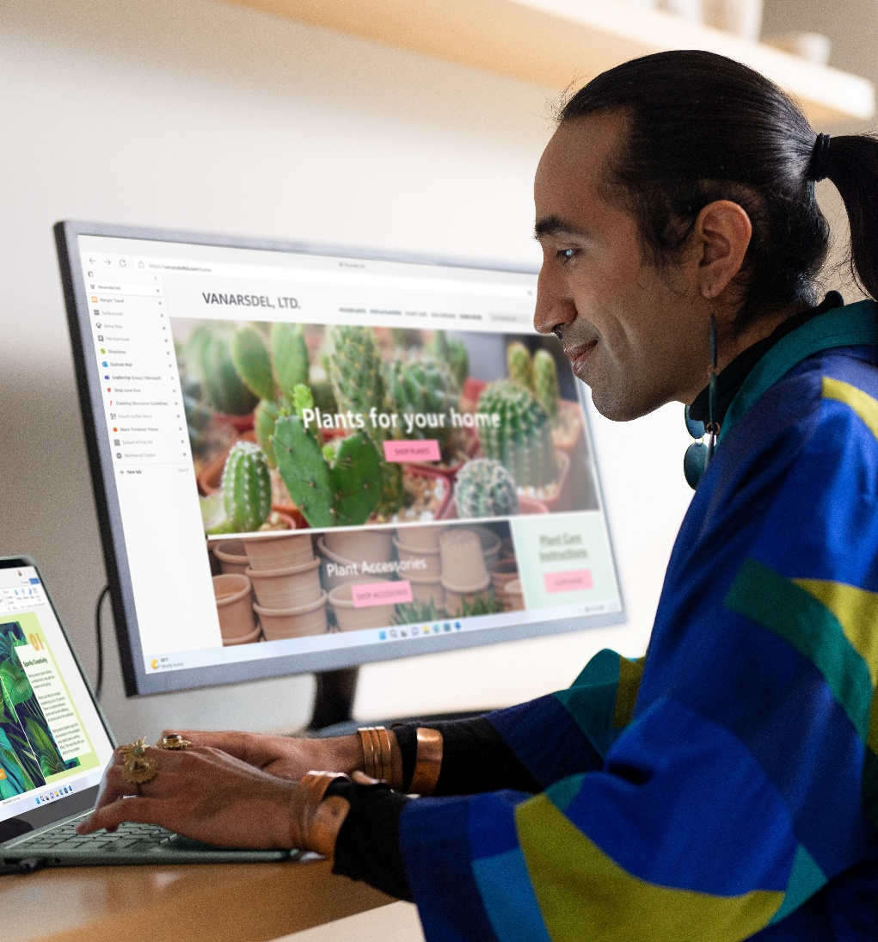
Challenge #8: Turn a doc into a deck
Use Copilot in PowerPoint to turn a document into a presentation
1
Open Microsoft PowerPoint
2
Click on the Copilot icon in the top right
3
Use this prompt:
“Create a deck based on /[select Word document] using our brand guidelines.”
4
Take a screenshot of the deck and paste it in box 8 on your trophy wall

Slide 13

Challenge #9: Analyze data
Use Copilot in Excel to easily analyze data
1
Open an existing sheet in Microsoft Excel
For this purpose, choose a spreadsheet that has data that can be summarized, for example survey responses or performance metrics
2
Click into an empty cell and type this formula:
“=COPILOT(“summarize this data of [insert description, like customer survey responses”,[select data range you want to analyze])”
3
Take a screenshot of Copilot’s response and paste it in box 9 on your trophy wall

Slide 14

Challenge #10: Minecraft yourself
Use Copilot Chat to create a background image that’s uniquely yours
1
Open Copilot Chat
2
Copy and paste this prompt.
Create a high-resolution background inspired by the Minecraft universe, featuring a bright daytime scene with a clear blue sky and soft, blocky clouds. The landscape includes [lush green hills, tall, pixelated trees, yellowish and orange colors]. Peaceful Minecraft animals such as big chickens, pigs, and pandas roam the grassy plains, adding life to the environment. A Minecraft character with [your features] wearing [your outfit] walks through the scene holding a [object of choice].
3
Replace the three placeholders in [ ] with your ideas and submit the prompt
4
Copy the image and paste it in box 10 on your trophy wall

